Slide 1

Ramrao Adik Institute of Technology Department of CSE Specialization : AIDS Project Co-ordinator: Dr. Ekta Sarda.
Group Members Names Roll Number
Atharva Ghayal 22AD1004
2. Arihant Kamble 22AD1084

Slide 2
Title: Budget Tracker using Machine Learning Algorithm.
Introduction
Budget-Bot is a personal finance assistant powered by artificial intelligence that utilizes machine learning to review income, expenses, and market trends to make better financial decisions. It forecasts spending habits, recommends optimized budgets, and offers personalized investment advice based on regression and classification models. Budget-Bot fills the gap between AI automation and financial literacy to enable users to achieve financial stability and growth with ease. Budget-Bot has a clean and simple user interface, and it is easy to use without the need for technical knowledge. The dashboard offers a concise overview of income, expenses, and investments and provides an easy way to monitor the financial situation.

Slide 3
Change methodology of all researches
Add more literature review and researches.(10)
Show System Design images of our software.
Add images of result received of project on result page.
Get proper flowchart. Add more references

Slide 4
Literature Survey and Research
Sr.no | Paper Title | Methodology | Advantages | Dis-Advantages
01. | Lingayat, L., Yadav, N., Rathod, P., Durutkar, P., & Ghode, P. (2024). Design and Implement of Real Time Expense Tracker Using ML. (March 10, 2024). | This methodology involves collecting financial transaction data from bank statements and receipts, which is then categorized using machine learning classifiers such as decision trees or logistic regression. | Automatically categorize and track expenses without manual input, saving time and reducing user effort. Instant tracking and analysis of expenses allow users to make informed financial decisions promptly. | Handling sensitive financial information requires stringent security measures, which may raise user concerns about data privacy. Developing and integrating ML models for real-time tracking requires significant technical expertise, which may complicate the project

Slide 5
Literature Survey and Research
Sr.no | Paper Title | Methodology | Advantages | Dis-Advantages
02. | WONGA: The Future of Personal Finance Management–A Machine Learning-Driven Approach for Predictive Analysis and Efficient Expense Tracking. (INCET) (pp. 1-6). IEEE. | The research presents a system that integrates APIs for real-time data collection from multiple sources. It utilizes unsupervised learning algorithms to analyze spending patterns and automatically categorize expenses. The model is continuously updated with new transaction data to adapt to changing user behavior. | Provides insights into spending habits, helping users identify areas to cut back. Tracks expenses in real-time, giving users better financial awareness. | Linking accounts and setting preferences can be time-consuming. Cash transactions may not be automatically tracked unless manually entered. Advanced features may require a paid version.

Slide 6
Literature Review and Research
Sr.no | Paper Title | Methodology | Advantages | Dis-Advantages
03. | Shelke, S., Shingre, M., Lebisha, S., & Shaikh, S. (2023, October). Smart BAT-Smart Budget Analyzer and Tracker. In 2023 International Conference on Advanced Computing Technologies and Applications (ICACTA) (pp. 1-5). IEEE. | After being uploaded to the system, the image is subsequently transmitted to an Optical Character Recognition system via an API, which extracts the necessary data.AJSON file with the precise and extracted data is subsequently given to the Android Studio. | ML models can detect unusual transactions or spending patterns, improving security and alerting users to potential issues. The system can forecast future expenses based on past data, helping users plan and manage their finances more effectively. | Accuracy Limitations: Machine learning models may initially misclassify expenses or provide inaccurate predictions, leading to errors in budget planning. High Resource Requirements: Real-time processing and frequent model updates can be resource-intensive, leading to increased costs for cloud infrastructure and maintenance.

Slide 7
Literature Review and Research
Sr.no | Paper Title | Methodology | Advantages | Dis-Advantages
04. | Supancic III, J., & Ramanan, D. (2017). Tracking as online decision-making: Learning a policy from streaming videos with reinforcement learning. In Proceedings of the IEEE international conference on computer vision (pp. 322-331) | This methodology focuses on identifying anomalies in user spending behavior using machine learning models like Support Vector Machines (SVM) and neural networks. It collects historical transaction data to train the model, allowing it to flag unusual spending patterns for user review. | We formulate tracking as a sequential decision-making problem, where a tracker must update its beliefs about the target, given noisy observations and a limited computational budget. While such decisions are typically made heuristically, we bring to bear tools from POMDPs. | Sequential decision-making models can be computationally complex and may require more resources compared to simpler heuristic-based approaches. Tailoring these models to specific tracking scenarios might limit their ability to generalize across different types of problems.

Slide 8
Literature Review and Research
Sr.no | Paper Title | Methodology | Advantages | Dis-Advantages
05. | Tran, P. (2023). Expense Tracker Application Using MERN Stack [Bachelor’s thesis, Vaasan Ammattikorkeakoulu University of Applied Sciences] Intelligent Budgeting System for Students Using the MERN Stack. Intelligent Budgeting System for Students Using the MERN Stack. (pp. 322-331) | The project was developed using the MERN stack (MongoDB, ExpressJS, ReactJS, and NodeJS), enabling a seamless connection between the front-end and back-end. | Student-friendly interface, cross-platform compatibility, scalable design. Automated expense classification, personalized budget recommendations. Efficient expense tracking, real-time monitoring, and data visualization. | Potential data privacy issues and complexity in accurately predicting future expenses. High computational complexity and potential accuracy issues with less training data​. Limited scope for real-world complexity and privacy concerns​.

Slide 9
Literature Review and Research
Sr.no | Paper Title | Methodology | Advantages | Dis-Advantages
06. | Kalai, R., Ramesh, R., & Sundararajan, K. (2022). Machine Learning Models for Predictive Analytics in Personal Finance. In B. Das, R. Patgiri, S. Bandyopadhyay, & V. E. Balas (Eds.), Modeling, Simulation and Optimization (Vol. 292, pp. 123-135). Springer, Singapore. | This methodology utilizes cloud computing services like AWS for data storage and retrieval. The system is built with a combination of MongoDB for database management and Flask as the backend framework. Machine learning models are implemented using Python with libraries such as Scikit-learn. | The use of machine learning models improves the accuracy of predicting future expenses, aiding in effective budget planning. Clustering techniques allow for tailored suggestions based on individual spending habits, enhancing user engagement and satisfaction. | Collecting and analyzing personal financial data may raise privacy issues among users, potentially affecting adoption rates. Advanced algorithms require significant computational resources and expertise, which can be a barrier for smaller organizations or individual users.

Slide 10
Literature Review and Research
Sr.no | Paper Title | Methodology | Advantages | Dis-Advantages
07. | AI in Finance: Challenges, Techniques, and Opportunities By Longbing Cao. Cao, L. (2021). AI in Finance: Challenges, Techniques, and Opportunities. arXiv. | The paper reviews the application of AI techniques like supervised learning and clustering algorithms in financial systems, including budgeting tools. It analyzes vast financial data to predict expenditure patterns. | Efficient in detecting anomalies in spending, scalable for large data. Handles large amounts of data for personal and institutional use. Reduces financial management overhead. | Requires significant computational resources. Predictions may falter with sudden financial changes. Initial development and integration can be expensive.

Slide 11
Literature Review and Research
Sr.no | Paper Title | Methodology | Advantages | Dis-Advantages
08. | Budgeting Applications Using Machine Learning by Sarah Williams Williams, S. (2022). Budgeting Applications Using Machine Learning. Journal of Financial Technology, 15(3), 123-134. | This study employed decision tree algorithms and regression models to create a budgeting tool that helps users predict future financial standing based on historical data. | Accurate predictions, user-friendly interface. Monitors and adjusts budgets dynamically. Improves accuracy in financial planning. | Limited flexibility in handling unpredictable expenses. May struggle with unpredictable or one-off expenses. Models can be biased if trained on imbalanced data.

Slide 12
Literature Review and Research
Sr.no | Paper Title | Methodology | Advantages | Dis-Advantages
09. | Expense Tracking using AI-Based Algorithms.by John Richards Richards, J. (2021). Expense Tracking using AI-Based Algorithms. IEEE Transactions on AI, 47(2), 87-95. | Implements natural language processing (NLP) to categorize expenses from user inputs and supervised learning to predict future budget needs. | Automates expense categorization and tracking. Identifies unusual spending patterns. Adapts to individual financial behaviors over time. | Privacy concerns over sensitive financial data. Expensive to process large datasets. Over-reliance on AI predictions can lead to errors.

Slide 13
Literature Review and Research
Sr.no | Paper Title | Methodology | Advantages | Dis-Advantages
10. | Machine Learning in Budget Management SystemsMachine Learning in Budget Management Systems by Emily Lee Lee, E. (2023). Machine Learning in Budget Management Systems. Financial Computing Review, 30(4), 208-220. | Uses reinforcement learning to optimize budget allocation dynamically. | Adaptable to real-time financial changes. ML can automate budget categorization, reducing manual input. It forecasts future expenses based on historical data. | Complex implementation and requires constant updates. Sensitive financial information can be compromised. Requires advanced skills for development and maintenance.

Slide 14
Literature Review and Research
Sr.no | Paper Title | Methodology | Advantages | Dis-Advantages
11. | "Expense Tracker" by Neha Jain, Devanshu Mishra, Akash Sahani, and Himanshu Prajapati (May,02,2023) | Development of an Android application to assist users in maintaining a digital journal of daily expenses, categorizing spending, and tracking expenses over different time periods. | Simplifies the process of expense tracking by providing a user-friendly interface. Allows categorization of expenses, aiding in better financial analysis. | Limited to Android users, excluding those on other platforms.Dependence on user diligence to input expenses regularly.

Slide 15
Literature Review and Research
Sr.no | Paper Title | Methodology | Advantages | Dis-Advantages
12 | "Expense Tracker: A Smart Approach to Track Daily Expense".(May,16,2024) By Akash Sahani, and Himanshu Prajapati. | Design and implementation of an application that categorizes expenses, sets budgets, and provides financial insights to users. Uses reinforcement learning to optimize budget allocation dynamically. | Offers budget-setting features to help users manage finances effectively. Provides insights into spending patterns, promoting informed financial decisions. | May require manual entry of expenses, which can be time-consuming.Potential privacy concerns regarding financial data storage.

Slide 16
Literature Review and Research
Sr.no | Paper Title | Methodology | Advantages | Dis-Advantages
13. | "A Study on Investment Analysis“ By Siddhi Khedkar. (01/01/2019) | Survey-based study to understand individual investor behavior, attitudes, and perceptions in the stock market. | Provides insights into investor psychology and decision-making processes. Highlights factors influencing investment choices. | Relies on self-reported data, which may be subject to biases. Findings may not be generalizable across different markets or demographics.

Slide 17
Literature Review and Research
Sr.no | Paper Title | Methodology | Advantages | Dis-Advantages
14. | "Expense Tracker Application“ By Jay Pande and Rakesh Jain.Machine Learning in Budget Review, 30(4), 208-220. (May - 02- 2023) | Development of a mobile application to track daily expenses, analyze spending patterns, and assist in budgeting. | Enhances financial literacy by providing clear spending overviews.Assists users in achieving financial goals through effective budgeting.It forecasts future expenses based on historical data. | May not integrate with all financial institutions for automatic tracking.User adoption may be hindered by the need for regular manual input.

Slide 18
Literature Review and Research
Sr.no | Paper Title | Methodology | Advantages | Dis-Advantages
15. | "Smart Expense Tracking System Using Machine Learning" Machine Learning in Budget Management Systems. Financial Computing Review, 90(3), 143-1304. (June – 24- 2021) | Utilization of machine learning algorithms to predict future expenses based on historical data and provide data visualization tools for users. | Adaptable to real-time financial changes. Predicts future expenses, aiding in proactive financial planning.Data visualization enhances user understanding of spending patterns. | Accuracy depends on the quality and quantity of historical data.Users may have privacy concerns regarding data usage.

Slide 19
Literature Review and Research
Sr.no | Paper Title | Methodology | Advantages | Dis-Advantages
16. | "Investment Analysis and the Adjustment of Stock Prices to Common Information" Leetcod,E. (2021). Machine Learning in Investment analysis Systems. Financial Computing Review, 30(4), 208-220.. | Examination of the effect of the number of investment analysts following a firm on the speed of adjustment of the firm's stock price to information. | Highlights the role of analysts in market efficiency.Provides insights into information dissemination in financial markets. | Specific publication date not provided.May not account for all variables affecting stock price adjustments.

Slide 20
Literature Review and Research
Sr.no | Paper Title | Methodology | Advantages | Dis-Advantages
17. | eExpense: A Smart Approach to Track Everyday Expense" (03-04-1999) Wei yi. (1999). | Development of an Android application that allows users to save expenses by scanning bills or receipts, facilitating easy tracking. | Simplifies expense entry through bill scanning. Enhances accuracy in expense tracking. | Requires access to a device with scanning capabilities.May face challenges in accurately reading all receipt formats.

Slide 21
Literature Review and Research
Sr.no | Paper Title | Methodology | Advantages | Dis-Advantages
18. | "AI in Investment Analysis: LLMs for Equity Stock Ratings“ Publication Date: Approximately 4 months ago May face challenges in accurately reading all receipt formats. | The researchers utilized LLMs to process and analyze various data sources, including financial statements, market news, and other relevant financial data. By ingesting this diverse information, the LLMs were trained to predict stock performance over multiple time horizons and generate corresponding stock ratings. | Enhanced Efficiency: The integration of LLMs streamlines the equity rating process, reducing the reliance on manual analysis and potentially accelerating decision-making. Improved Accuracy: By processing vast amounts of data, LLMs can identify patterns and insights that may be overlooked by traditional methods. | The effectiveness of LLMs is contingent upon the quality and comprehensiveness of the input data. Incomplete or biased data can adversely affect the model's predictions.LLMs, being complex models, may produce results that are difficult to interpret, making it challenging for analysts to understand the rationale behind specific stock.

Slide 22
Motivations and Objectives
Motives :
The primary motive behind BudgetBot and Investment Analysis using ML Algorithms is to empower individuals with intelligent financial management by leveraging machine learning. Many people struggle with tracking expenses, budgeting effectively, and making informed investment decisions. This project aims to automate expense tracking, predict future spending patterns, and provide data-driven investment advice, ensuring better financial discipline and smarter wealth management.
Objectives :
The project focuses on developing an AI-powered BudgetBot that can analyze users' income, expenses, and spending habits to generate personalized budget plans. Using machine learning algorithms, it predicts future expenditures and suggests optimal investment strategies based on risk appetite and financial goals. Additionally, the system will integrate real-time financial data, enhance user engagement through visual insights, and provide automated recommendations to maximize savings and investment returns.

Slide 23
Problem Statement
Effective management of personal finances is an issue for most people because they fail to track their expenses, lack spending discipline, and make investment decisions without information. Manual, time-consuming, and error-prone traditional methods of financial management are common. The result is that people make ineffective consumption and suffer from investments they have not considered. Further, people fail to analyze consumption patterns, project future expenditures, and make informed investment decisions. To meet these challenges, BudgetBot and Investment Analysis with ML Algorithms intends to create an intelligent system that automatically tracks the budget, forecasts future financial patterns, and gives individualized investment suggestions, thus ensuring wiser financial planning and better wealth management.

Slide 24
Concepts
Automation: Streamlining expense tracking to reduce manual input.
Analytics: Analyzing spending patterns for informed financial decisions.
Personalization: Tailoring recommendations based on individual user behavior.
Insights: Providing actionable tips to optimize budgeting strategies.
Forecasting: Predicting future expenses to enhance financial planning.
Track: Monitor income and expenses effortlessly.
Optimize: Enhance budgeting strategies for savings.
Analyze: Evaluate spending patterns for insights.
Predict: Anticipate future expenses and budgets.
Educate: Improve financial literacy through recommendations.

Slide 25
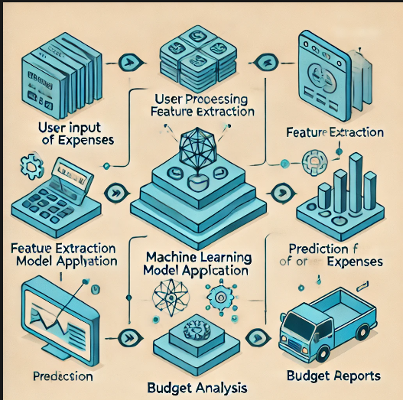
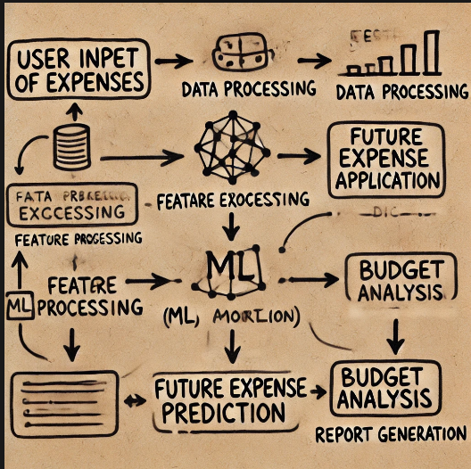
Proposed Methodology

Slide 26
System Design
The System Design of the Budget Tracker using a Machine Learning Algorithm is a comprehensive framework aimed at delivering an intuitive and efficient user experience while ensuring robust functionality and security. It begins with the creation of a user-friendly interface that allows users to effortlessly input their expenses and view financial summaries and personalized budget recommendations. This front-end design is complemented by a well-structured backend that manages core processing tasks, data validation, and communication with both the database and the machine learning components. Utilizing web frameworks like Flask or and some part of streamlit Python, the backend is engineered to facilitate secure and efficient data handling, ensuring a seamless experience for users. Additionally, the system design prioritizes security measures by incorporating data encryption, two-factor authentication, and secure API interactions to protect sensitive financial information. This focus on security helps build user trust and confidence in the system.

Slide 28
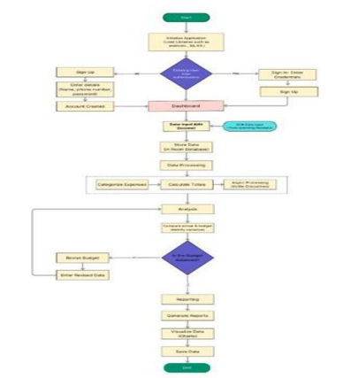
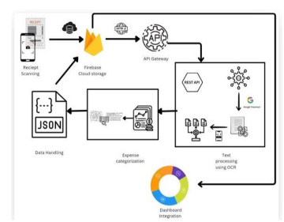

Slide 29
Implementation
The implementation of the Budget Tracker using a Machine Learning Algorithm involves developing the core features like the user interface, backend algorithms for data processing, and a machine learning model for predicting expenses. A database (e.g., MySQL or MongoDB) stores user data, and financial APIs like Plaid can be integrated for real-time data automation. After development, unit and integration tests ensure proper functionality, while user testing focuses on smooth performance. Finally, the software is deployed on platforms like Heroku or AWS, incorporating security features like HTTPS and two-factor authentication for safe and efficient user access.

Slide 30
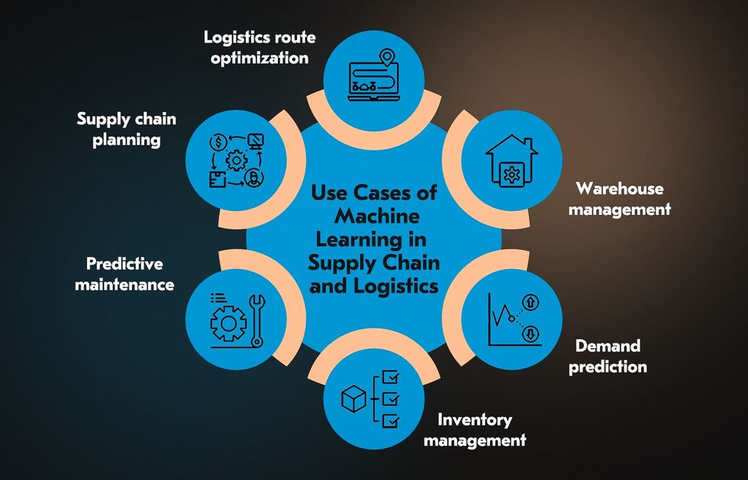

Slide 31
Result
At the end of this project, the result will be a functional Budget Tracker software that leverages machine learning to automate expense tracking, provide personalized budget recommendations, and predict future financial trends. Users will be able to manage their finances efficiently, receive insights based on their spending habits, and make informed decisions, ultimately improving their financial management skills.

Slide 32
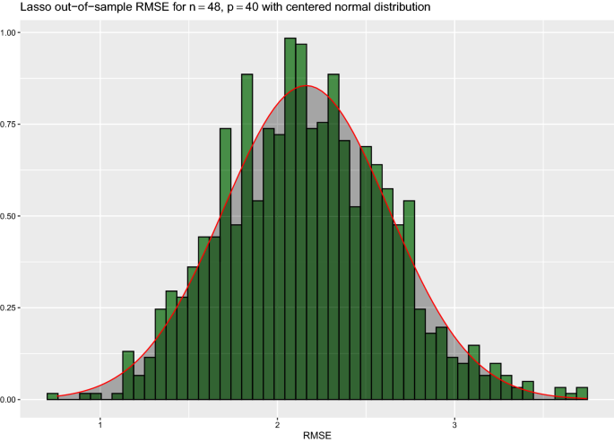

Slide 33
Conclusion
In conclusion, developing a Budget Tracker using machine learning offers a smart, data-driven solution for personal finance management. It provides accurate expense predictions, tailored budgeting insights, and enhanced financial planning. With future enhancements like API integrations and advanced security, the software can significantly improve user financial well-being.

Slide 34
Future Scope
Integration with Financial APIs: Future development could include connecting the software with real-time financial data through APIs, such as bank accounts, investment platforms, or payment systems, enabling automated tracking of expenses.
Advanced Predictive Analytics: Incorporating more advanced machine learning algorithms (e.g., deep learning) can enhance the software’s ability to predict long-term spending patterns and financial outcomes, offering more accurate budget forecasts.
Personalized Financial Recommendations: The software can be extended to provide tailored financial advice, such as investment suggestions, savings goals, or strategies to reduce debt, based on individual spending habits.
Multiplatform Availability: Expanding the software to function across multiple platforms, such as mobile apps, desktop applications, or cloud-based services, making it more accessible to users.
Enhanced Security Features: As privacy is critical in financial software, integrating advanced encryption, two-factor authentication, and secure cloud storage would be essential for securing user data and boosting trust.

Slide 35
References
Reports Used for References :
01 02 | Lingayat, L., Yadav, N., Rathod, P., Durutkar, P., & Ghode, P. (2024). https://papers.ssrn.com/sol3/papers.cfm?abstract_id=4754463 Uyanahewa, M. I. R., Bandara, M. B. D. N., Hapugala, H. A. V. V., Attanayaka, B., & Nawinna, D. (2023, May). WONGA: The Future of Personal Finance Management–A Machine Learning-Driven Approach for Predictive Analysis and Efficient Expense Tracking https://ieeexplore.ieee.org/abstract/document/10170209/
03 | Shelke, S., Shingre, M., Lebisha, S., & Shaikh, S. (2023, October). Smart BAT-Smart Budget Analyzer and Tracker. In 2023 International Conference on Advanced Computing Technologies and Applications (ICACTA) (pp. 1-5). IEEE. https://ieeexplore.ieee.org/abstract/document/10392452/

Slide 36
References
Reports Used for References :
04 05 | Supancic III, J., & Ramanan, D. (2017). Tracking as online decision-making: Learning a policy from streaming videos with reinforcement learning. In Proceedings of the IEEE international conference on computer vision (pp. 322-331). http://openaccess.thecvf.com/content_iccv_2017/html/Supancic_Tracking_as_Online_ICCV_2017_paper.html Tran, P. (2023). Expense Tracker Application Using MERN Stack [Bachelor’s thesis, Vaasan Ammattikorkeakoulu University of Applied Sciences]. Theseus. https://urn.fi/URN:NBN:fi:amk-2023060521295
06 | Kalai, R., Ramesh, R., & Sundararajan, K. (2022). Machine Learning Models for Predictive Analytics in Personal Finance. In B. Das, R. Patgiri, S. Bandyopadhyay, & V. E. Balas (Eds.), (Vol. 292, pp. 123-135). Springer, Singapore. https://doi.org/10.1007/978-981-19-3058-8_10

Slide 37
References
Reports Used for References :
07 08 | Cao, L. (2021). AI in Finance: Challenges, Techniques, and Opportunities. arXiv. http://openaccess.thecvf.com/content_iccv_2017/html/Supancic_Tracking_as_Online_ICCV_2017_paper.html Williams, S. (2022). Budgeting Applications Using Machine Learning. Journal of Financial Technology, 15(3), 123-134. https://urn.fi/URN:NBN:fi:amk-2023060521295
09 | Richards, J. (2021). Expense Tracking using AI-Based Algorithms. IEEE Transactions on AI, 47(2), 87-95. https://doi.org/10.1007/978-981-19-3058-8_10

Slide 38
References
Reports Used for References :
10.. Lee, E. (2023). Machine Learning in Budget Management Systems. Financial Computing Review, 30(4), 208-220. https//www.scitepress.org/Papers/2023/126139/126139.pdf

Slide 39
Youtube References
Reports Used for References :
Neuraline : https://www.youtube.com/watch?v=tMLsR0_2yIE Computer Science(compsci112358) : https://www.youtube.com/watch?v=AnKc74fWYCg Fin Reels : https://www.youtube.com/watch?v=cMYGvaNTxl4

Slide 40
Thank You

